Slide 1
COLLEGE OF DENTAL SCIENCES
LIBRARY & INFORMATION CENTRE ORIENTATION PROGRAMME & EBSCO Training Session
VENUE: CODS Auditorium DATE: 11.12.2023

Slide 2
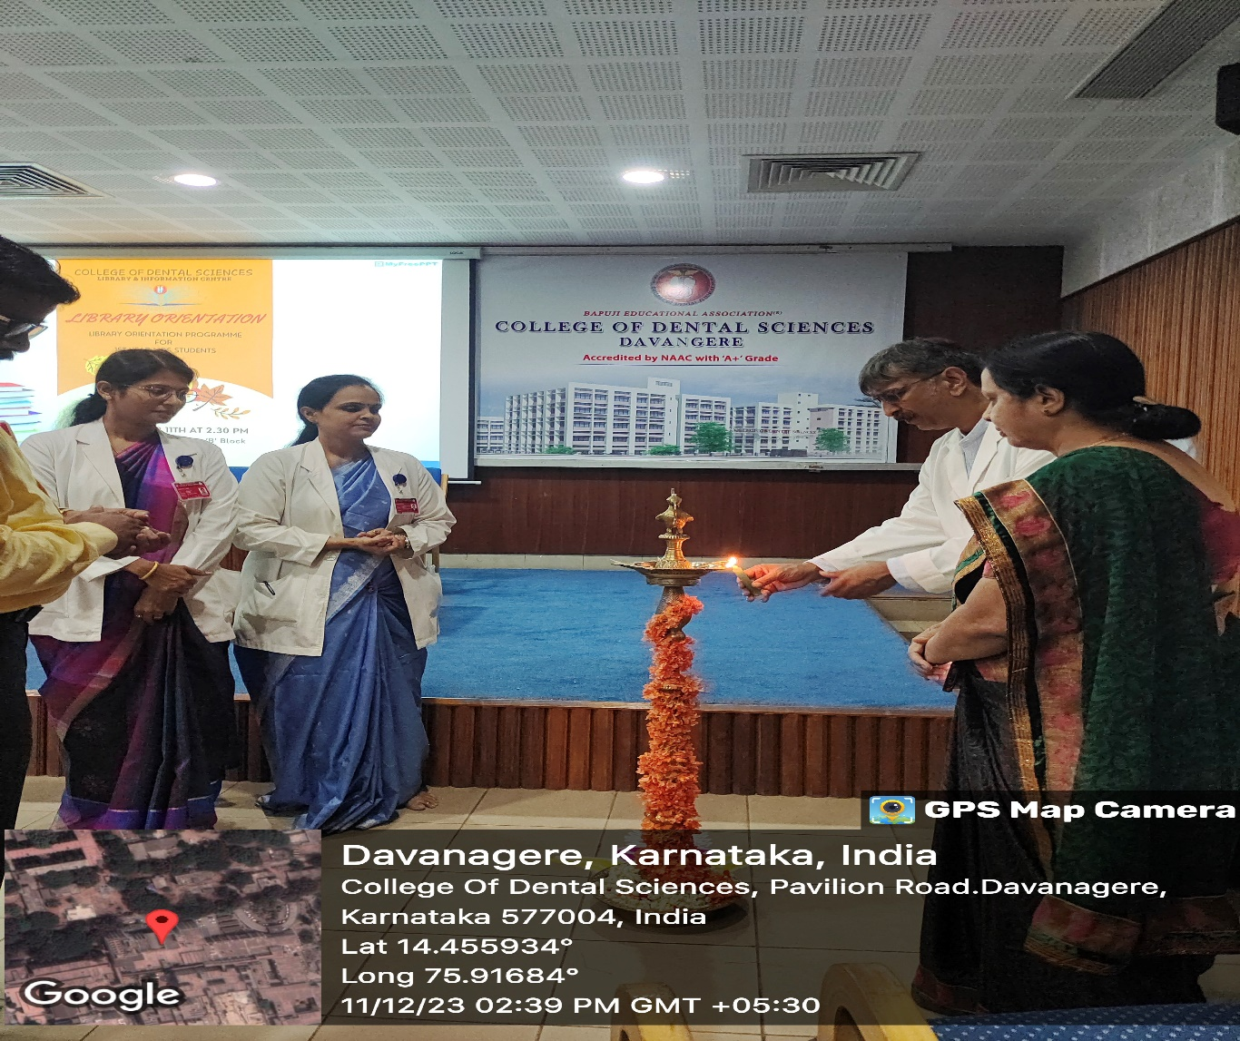
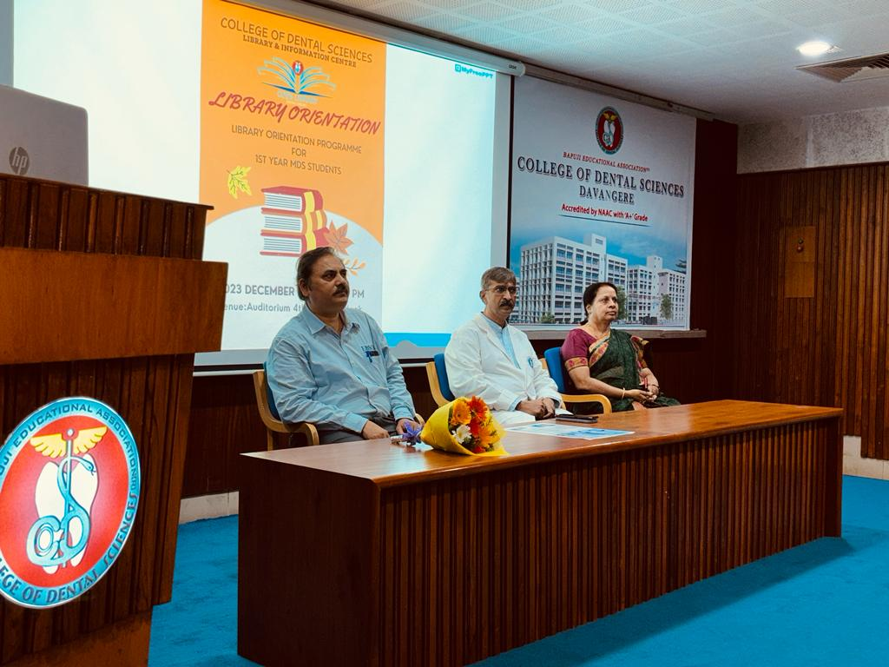
Orientation Programme was organized for MDS Students & Teaching Staff on 11th December 2023. Mr Upadhyaya G.K. Dr. Ali I.M. Principal, Dr. Mamatha G.P. Academic Dean, were the chief guest for the program.

Slide 3
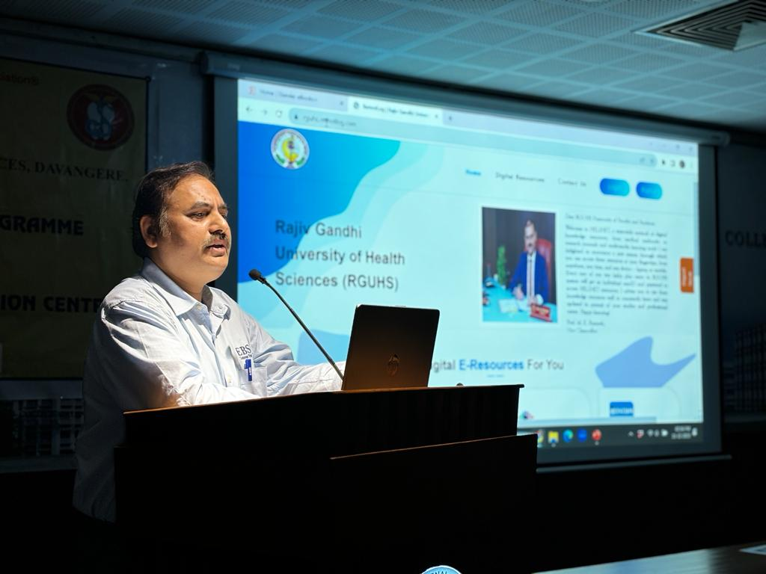
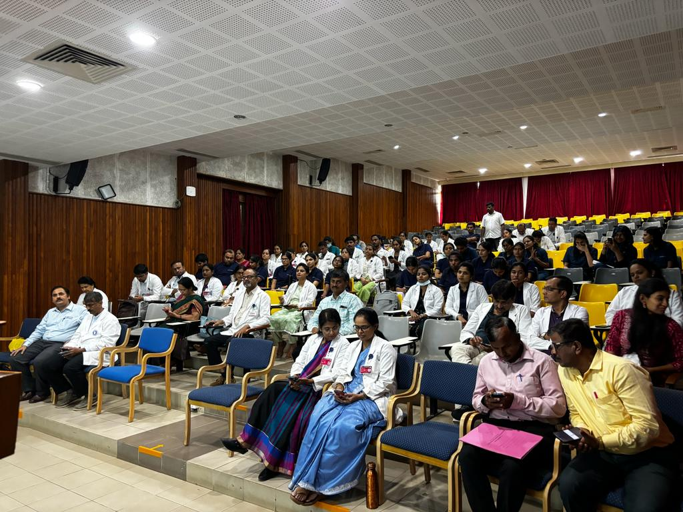
Mr. Upadhyaya G.K. EBSCO resource person explained about RGUHS-HELINET Consortium E-resources in detail

Slide 4
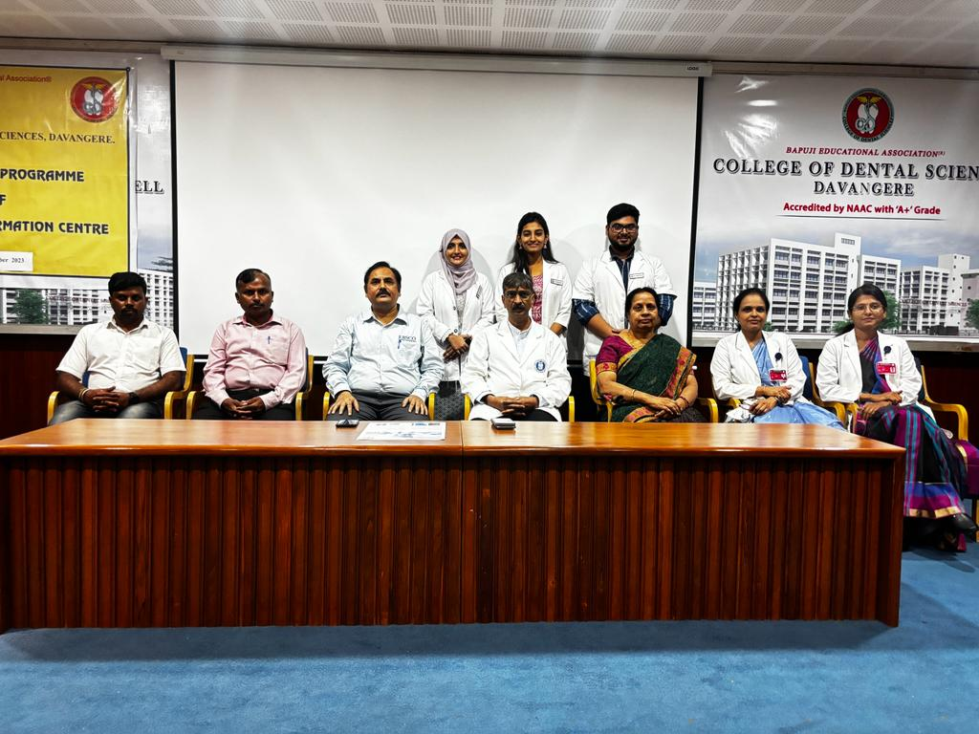
Group photo of Library committee along with Chief Guest

